Slide 1
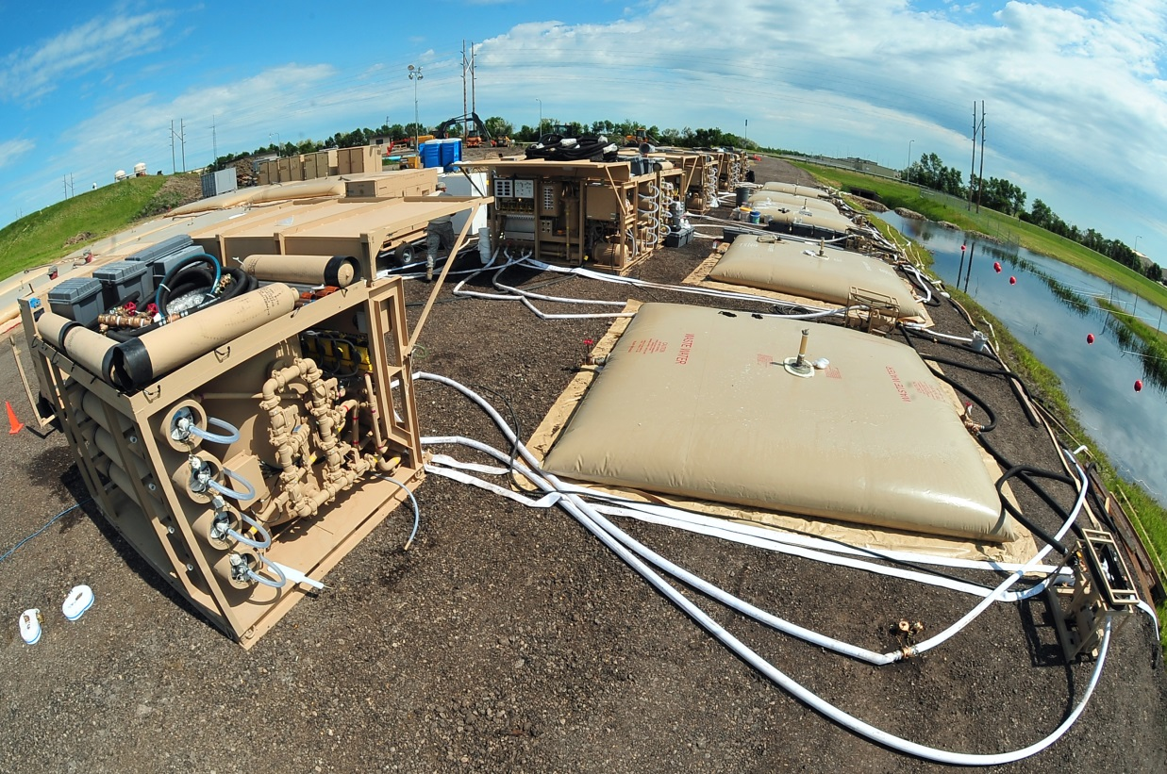
1500 GPH Reverse osmosis Water Purification Unit
ROWPU
Part Number: 701-1500ROWPU
NSN: 4610-01-530-3255
Dimensions (Closed): 108” L x 88” W x 84” H
Weight (Packed): 8,400 lbs (2,286 kg)
USAF, FEMA and NATO Standard
1,500 to 1,800 Gallons Per Hour of Water
Fully NBC Capable
Single Pallet Position

Slide 2
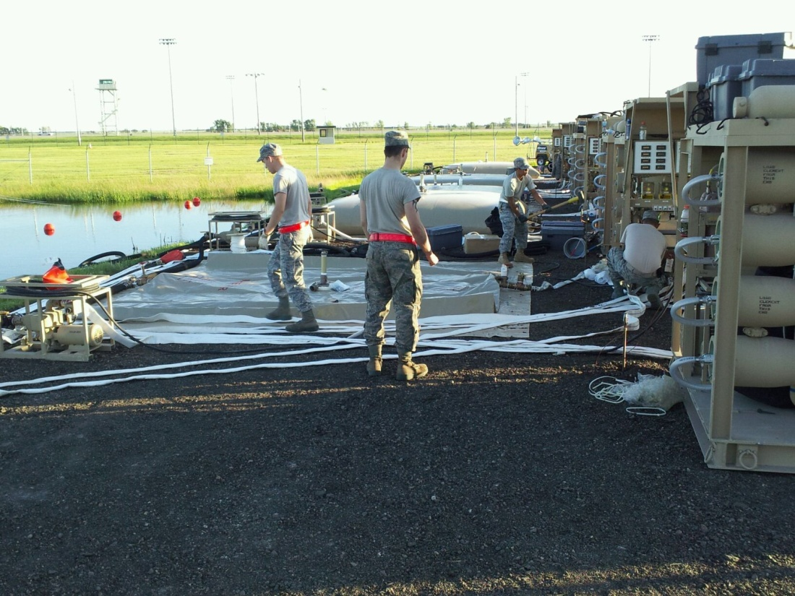
1500 ROWPU
(Continued)
The 1500 ROWPU was developed by HEI for the USAF. It is the only mobile water purification device on the market that meets the tough demands of the USAF. The unit is in full compliance with the USAF Purchase Description, and is fully tested, fielded and trained within the USAF.
All operation and maintenance is covered in USAF Technical Order TO 40W4-20-1. All water produced is in full accordance with DOD Standards and Regulations. Unit as supplied comes with all components necessary for 100 hours of operation. Supplied unit does not include water storage bladders or bags and the power source. Full specifications available upon request.

Slide 3
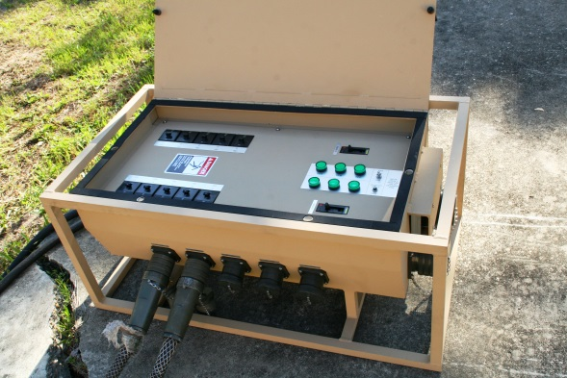
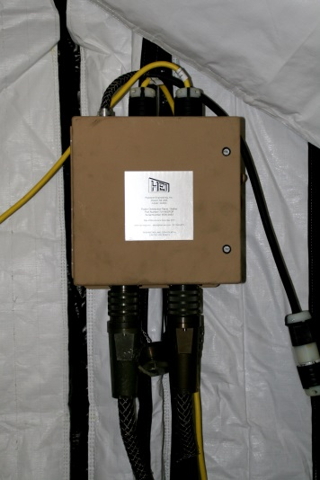
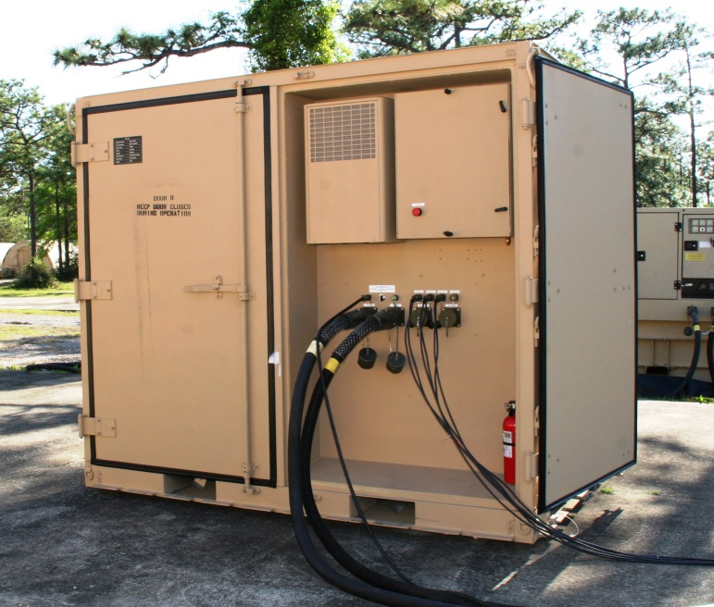
Power Distribution Solutions
400 A Power Distribution Panels
60 Amp Power Distribution Panels
Many Other Custom Solutions

Slide 4
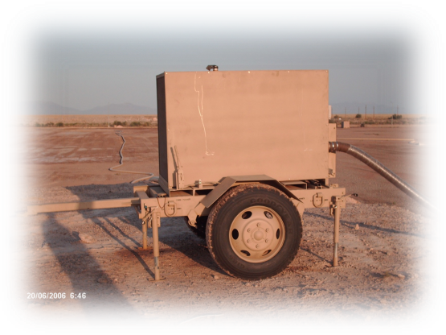
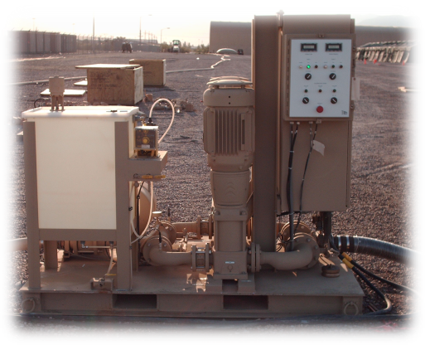
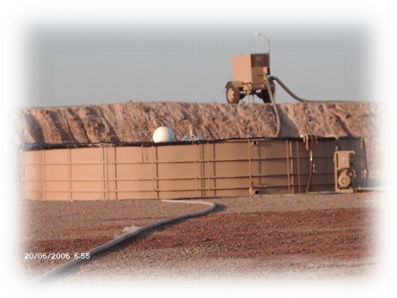
Water Storage and Distribution Solutions
Supplier of BEAR Water System Components
Source Run Pump (400 GPM)
Dual Pumping Station (350 GPM)
25,000 Gallon Quick Erect Tank
Waste Aeration and Mixing System
All BEAR Subsystems Including:
Source Run
150 Man Water Production
550 Initial Set
550 Follow-on Set
Many Others
USMC Tactical Water and Fuel System Components

