Slide 1
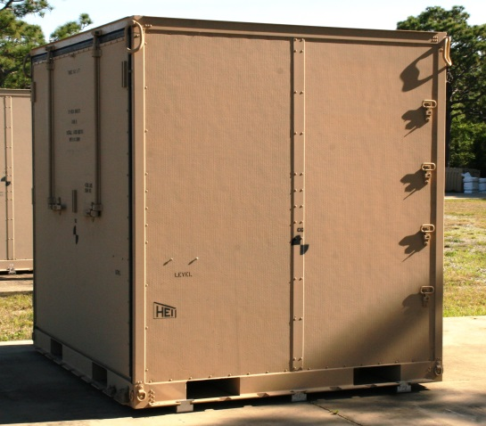
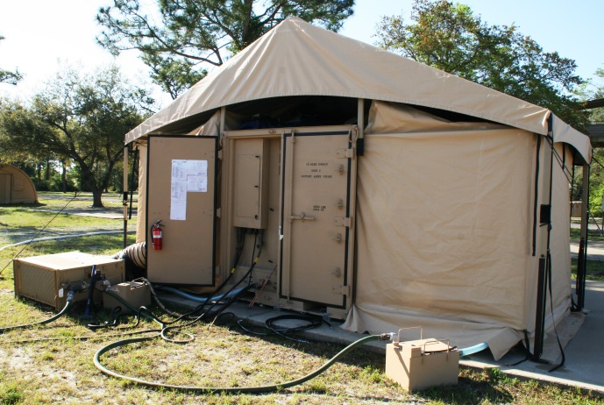
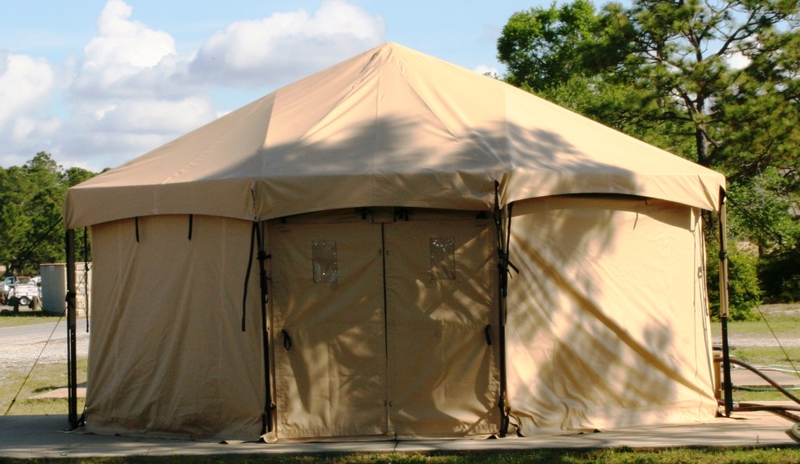
Highland Engineering, Inc.
1153 Grand Oaks Drive
Howell, MI 48843
(517) 548-4372 (517) 548-4423 (Fax)
Water Treatment and Troop Support Specialists
Joint Expeditionary a-Transportable Shower System (JETSS)
10 HEAD
Part Number: 701-EEAC-10SV2.0
Dimensions (Closed): 108” L x 88” W x 90” H
Dimensions (Open): Approximately 22’ W x 17’ Deep
Weight (Packed): 4,550 lbs (2,064 kg)
The system interfaces with the aircraft palletized cargo handling system rails and locks - additional restraint is not required. System is certifiable by ATTLA for internal air transport.

Slide 2
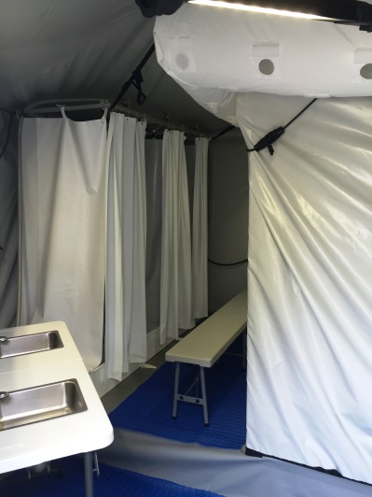
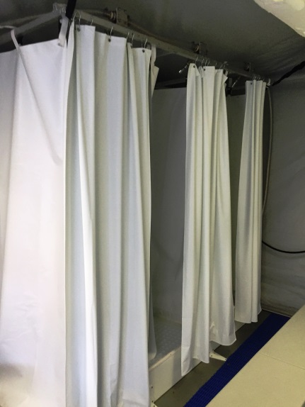
Highland Engineering, Inc.
1153 Grand Oaks Drive
Howell, MI 48843
(517) 548-4372 (517) 548-4423 (Fax)
Water Treatment and Troop Support Specialists
JETSS – 10 Head
(Continued)
SINGLE AIRLIFT PALLET POSITION
Completely Self-Contained – No additional equipment required for operation
Minimal Operational Set-up Time - Less than 45 minutes with four personnel
10 Private individual Shower Stalls
4 Shave Sinks
Integral Supply Pump and Waste Pump
On-Board On-Demand Diesel Fueled water heaters with Bypass
High Efficiency LED Lighting with Blackout capability
Insulated ECU Ducting
2 EA 3000 gallon Water Storage Bladders
Single 208 VAC, 60A, 3 Phase Military Power Input with Auxiliary connections – no PDP required (User Selectable 200A or 60A)
External Frame, High Fabric Clearance
HVAC Ducting and Plenum
Hybrid Thermal Fly
Semi-Hard Entry Doors
DISTRIBUTION STATEMENT / LIMITED RIGHTS
Data contained herein is proprietary to Highland Engineering, Inc. and may not be used, disclosed, reproduced, modified, performed, or displayed without the prior written approval of Highland Engineering, Inc. This data is submitted with Limited Rights. This data may be reproduced and used by the government with the express limitation that they will not, without written permission of Highland Engineering, Inc., be used for purposes of manufacture nor disclosed outside the government, except that the government may disclose this data outside the government for the following purposes, if any, provide that the government makes such disclosure subject to prohibition against further use and disclosure: None.

Slide 3
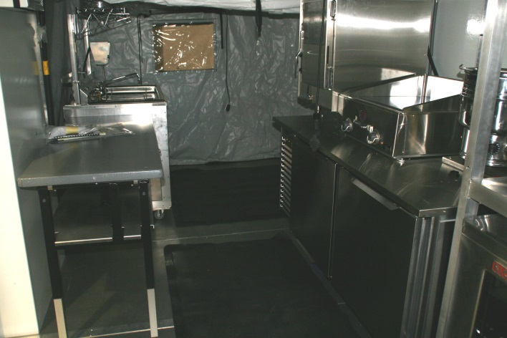
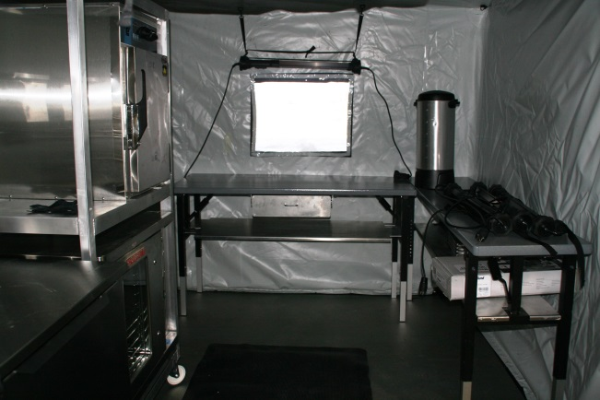
Highland Engineering, Inc.
1153 Grand Oaks Drive
Howell, MI 48843
(517) 548-4372 (517) 548-4423 (Fax)
Water Treatment and Troop Support Specialists
Joint Air-transportable Containerized Kitchen (JACK)
Part Number: 701-EEAC-KITV2.0
Dimensions (Closed): 108” L x 88” W x 90” H
Dimensions (Open): Approximately 22’ W x 17’ Deep
Weight (Packed): 5,904 lbs (2,541 kg)
The system interfaces with the aircraft palletized cargo handling system rails and locks - additional restraint is not required. System is certifiable by ATTLA for internal air transport.

Slide 4
Highland Engineering, Inc.
1153 Grand Oaks Drive
Howell, MI 48843
(517) 548-4372 (517) 548-4423 (Fax)
Water Treatment and Troop Support Specialists
JACK
(Continued)
SINGLE AIRLIFT PALLET POSITION
External Frame, High Clearance Fabric
Improved HAVC Ducting and Plenum System
Hybrid Thermal Fly
Semi-Hard Entry Door
200A/60A Dual Power input (Field selectable) with auxiliary outlets – no PDP required
Additional 60A Outlet
Completely Self-Contained – no additional equipment required for operation
Minimal Operational Set-up Time - Less than one hour with four personnel
Full Diesel Fueled Tray Ration Capability and full Electric Capability – IN THE SAME PACKAGE
Supports UGR-A, UGR-B, UGR-H & S, and limited Fresh Foods
Multiple Insulated Food Carriers and Beverage Containers for forward Support
Serving Windows on either end
High Efficiency LED Lighting with Blackout capability
2 Insulated ECU Ducts
2 EA 3000 gallon water storage bladders
Tray Pack Heater with burner, fuel lines and fuel can.
Refrigerator
Sanitation Sink – Three Compartment with Heater and Water Pumps
Steam Kettle
Steam and Hold Oven
Cook and Hold Oven
Blodgett Oven
Griddle
Coffee Urn
DISTRIBUTION STATEMENT / LIMITED RIGHTS
Data contained herein is proprietary to Highland Engineering, Inc. and may not be used, disclosed, reproduced, modified, performed, or displayed without the prior written approval of Highland Engineering, Inc. This data is submitted with Limited Rights. This data may be reproduced and used by the government with the express limitation that they will not, without written permission of Highland Engineering, Inc., be used for purposes of manufacture nor disclosed outside the government, except that the government may disclose this data outside the government for the following purposes, if any, provide that the government makes such disclosure subject to prohibition against further use and disclosure: None.

Slide 5
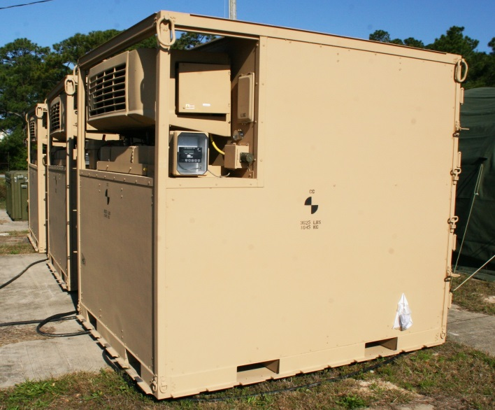
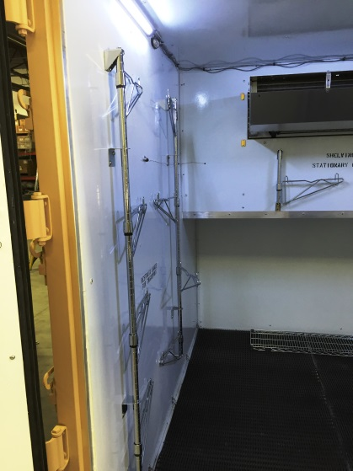
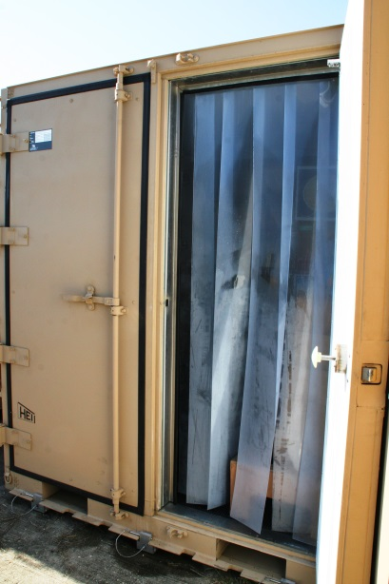
Highland Engineering, Inc.
1153 Grand Oaks Drive
Howell, MI 48843
(517) 548-4372 (517) 548-4423 (Fax)
Water Treatment and Troop Support Specialists
Expeditionary Airlift Refrigeration Container System
Part Number: 701-EAC-REF
Dimensions: 108” L x 88” W x 97” H
Weight Tare: 3,250 lbs
Interior Weight Capacity 6,750 lbs
Interior Volume 325 cu ft
The system interfaces with the aircraft palletized cargo handling system rails and locks - additional restraint is not required. System is certifiable by ATTLA for internal air transport.

Slide 6
Highland Engineering, Inc.
1153 Grand Oaks Drive
Howell, MI 48843
(517) 548-4372 (517) 548-4423 (Fax)
Water Treatment and Troop Support Specialists
Expeditionary Airlift Refrigeration Container System
(Continued)
SINGLE AIRLIFT PALLET POSITION
NO OVERHANG
Interior cube approximately 325 cu ft
Three Power sources
Diesel - Powered by latest generation Kubota CT3-44 Engine. Tier 4 compliant with integral fuel tank – over 24 hour run time at normal loads
208 VAC, 3 Phase, 60 A Class L Receptacle for shore power
208 VAC, 3 Phase Aircraft Power Connector
Interior vinyl strip door to significantly reduce temperature swings and compressor load
Interior D Rings for securing loads
Temperature Range -20° F to 86° F
Operating Temperature Range (Ambient) -20º F to 130º F
Storage Temperature Range (Ambient) -30º F to 160º F
Industry Leading Carrier Refrigeration Unit
Interior designed to FDA and NSF Standards
Improved door seals – current prone to failure and sticking
Interior LED Lighting with Blackout – Runs off battery power with time to provide for lighting even while running on diesel power.
New door latching mechanism allowing for air certification of filled container
Commonality of hardware with other systems – reduced life cycle costs
DISTRIBUTION STATEMENT / LIMITED RIGHTS
Data contained herein is proprietary to Highland Engineering, Inc. and may not be used, disclosed, reproduced, modified, performed, or displayed without the prior written approval of Highland Engineering, Inc. This data is submitted with Limited Rights. This data may be reproduced and used by the government with the express limitation that they will not, without written permission of Highland Engineering, Inc., be used for purposes of manufacture nor disclosed outside the government, except that the government may disclose this data outside the government for the following purposes, if any, provide that the government makes such disclosure subject to prohibition against further use and disclosure: None.

Slide 7
Highland Engineering, Inc.
1153 Grand Oaks Drive
Howell, MI 48843
(517) 548-4372 (517) 548-4423 (Fax)
Water Treatment and Troop Support Specialists
Joint Expeditionary air-Transportable Shower System (JETSS)
5 HEAD
Part Number: 701-EEAC-5SV2.0
Dimensions (Closed): 108” L x 88” W x 90” H
Dimensions (Open): Approximately 22’ W x 17’ Deep
Weight (Packed): 4,350 lbs (1,973 kg)
The system interfaces with the aircraft palletized cargo handling system rails and locks - additional restraint is not required. System is certifiable by ATTLA for internal air transport.

Slide 8
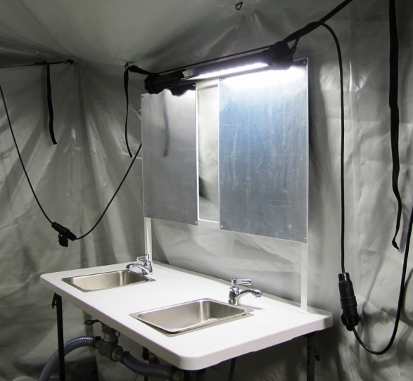
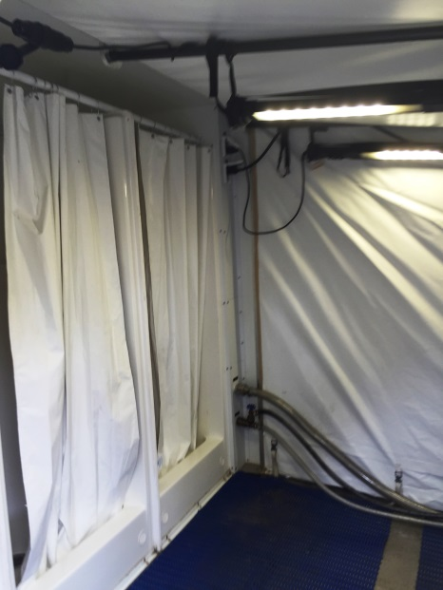
Highland Engineering, Inc.
1153 Grand Oaks Drive
Howell, MI 48843
(517) 548-4372 (517) 548-4423 (Fax)
Water Treatment and Troop Support Specialists
JETSS – 5 Head
(Continued)
SINGLE AIRLIFT PALLET POSITION
Completely Self-Contained – No additional equipment required for operation
Minimal Operational Set-up Time - Less than 45 minutes with four personnel
5 Private individual Shower Stalls
4 Shave Sinks
Integral Supply Pump and Waste Pump
On-Board On-Demand Diesel Fueled water heaters with Bypass
High Efficiency LED Lighting with Blackout capability
Insulated ECU Ducting
2 EA 3000 gallon Water Storage Bladders
Single 208 VAC, 60A, 3 Phase Military Power Input with Auxiliary connections – no PDP required (User Selectable 200A or 60A)
External Frame, High Fabric Clearance
HVAC Ducting and Plenum
Hybrid Thermal Fly
Semi-Hard Entry Doors
DISTRIBUTION STATEMENT / LIMITED RIGHTS
Data contained herein is proprietary to Highland Engineering, Inc. and may not be used, disclosed, reproduced, modified, performed, or displayed without the prior written approval of Highland Engineering, Inc. This data is submitted with Limited Rights. This data may be reproduced and used by the government with the express limitation that they will not, without written permission of Highland Engineering, Inc., be used for purposes of manufacture nor disclosed outside the government, except that the government may disclose this data outside the government for the following purposes, if any, provide that the government makes such disclosure subject to prohibition against further use and disclosure: None.

Slide 9
Highland Engineering, Inc.
1153 Grand Oaks Drive
Howell, MI 48843
(517) 548-4372 (517) 548-4423 (Fax)
Water Treatment and Troop Support Specialists
Rapid Air Transportable Laundry (RATL)
(Self Help)
Part Number: 701-EEAC-SHLV2.0
Dimensions (Closed): 108” L x 88” W x 90” H
Dimensions (Open): Approximately 22’ W x 17’ Deep
Weight (Packed): 5,039 lbs (2,286 kg)
The system interfaces with the aircraft palletized cargo handling system rails and locks - additional restraint is not required. System is certifiable by ATTLA for internal air transport.

Slide 10
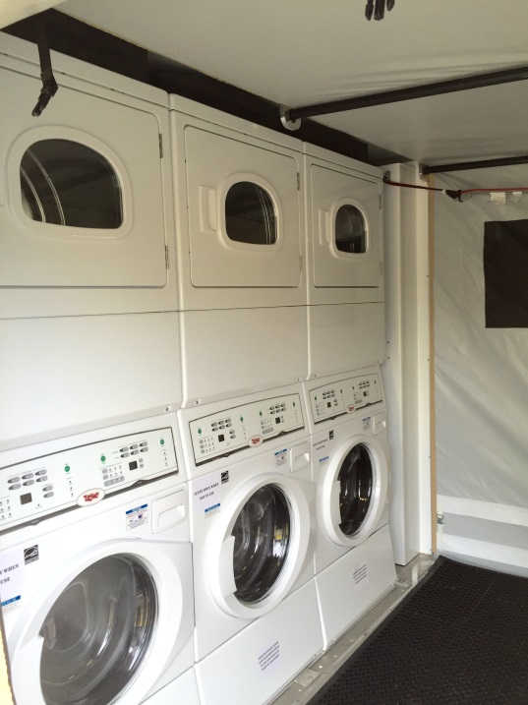
Highland Engineering, Inc.
1153 Grand Oaks Drive
Howell, MI 48843
(517) 548-4372 (517) 548-4423 (Fax)
Water Treatment and Troop Support Specialists
RATL
(Continued)
SINGLE AIRLIFT PALLET POSITION
Completely Self-Contained – No additional equipment required for operation
Minimal Operational Set-up Time - Less than 45 minutes with four personnel
5 COMMERCIAL grade stacked Washer/Dryer units – High efficiency water savers
Integral Supply Pump and Waste Pump
On-demand Electric Water Heat for one washer - Medical services use
High Efficiency LED Lighting with Blackout capability
2 EA 3000 gallon Water Storage Bladders
Single 208 VAC, 200A, 3 Phase Military Power Input with Auxiliary connections – no PDP required
External Frame, High Clearance Fabric
Hybrid Thermal Fly
Semi-hard Entry Doors
DISTRIBUTION STATEMENT / LIMITED RIGHTS
Data contained herein is proprietary to Highland Engineering, Inc. and may not be used, disclosed, reproduced, modified, performed, or displayed without the prior written approval of Highland Engineering, Inc. This data is submitted with Limited Rights. This data may be reproduced and used by the government with the express limitation that they will not, without written permission of Highland Engineering, Inc., be used for purposes of manufacture nor disclosed outside the government, except that the government may disclose this data outside the government for the following purposes, if any, provide that the government makes such disclosure subject to prohibition against further use and disclosure: None.

Slide 11
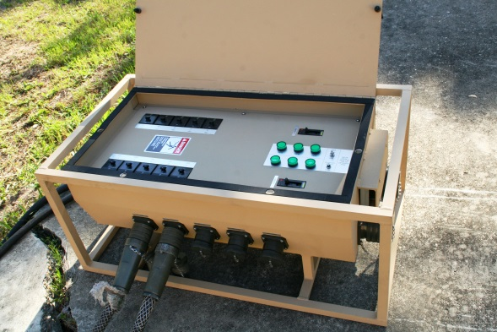
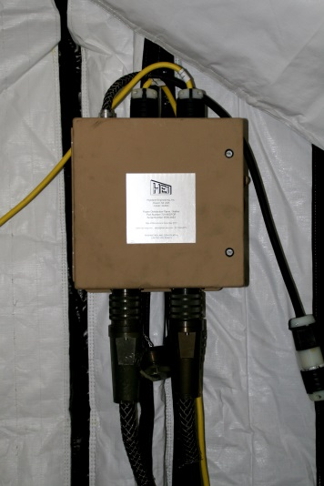
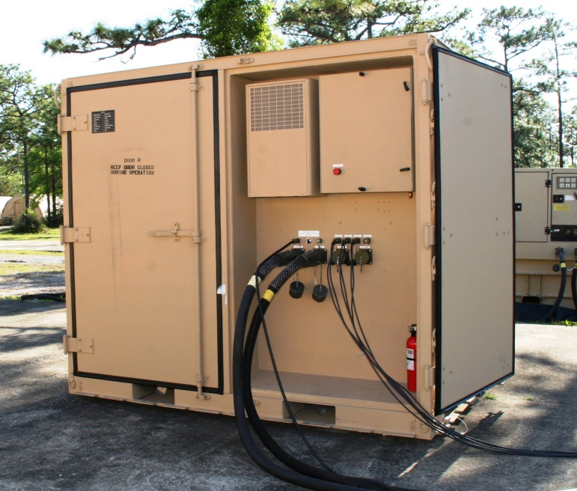
Highland Engineering, Inc.
1153 Grand Oaks Drive
Howell, MI 48843
(517) 548-4372 (517) 548-4423 (Fax)
Water Treatment and Troop Support Specialists
Power Distribution Solutions
400 A Power Distribution Panels
60 Amp Power Distribution Panels
Many Other Custom Solutions
DISTRIBUTION STATEMENT / LIMITED RIGHTS
Data contained herein is proprietary to Highland Engineering, Inc. and may not be used, disclosed, reproduced, modified, performed, or displayed without the prior written approval of Highland Engineering, Inc. This data is submitted with Limited Rights. This data may be reproduced and used by the government with the express limitation that they will not, without written permission of Highland Engineering, Inc., be used for purposes of manufacture nor disclosed outside the government, except that the government may disclose this data outside the government for the following purposes, if any, provide that the government makes such disclosure subject to prohibition against further use and disclosure: None.

Slide 12
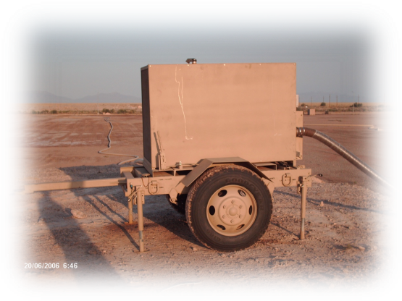
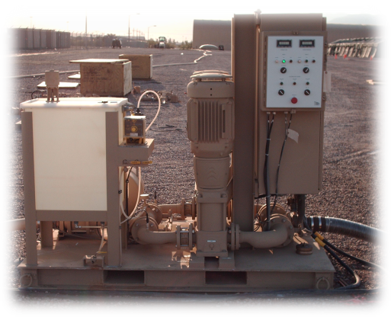
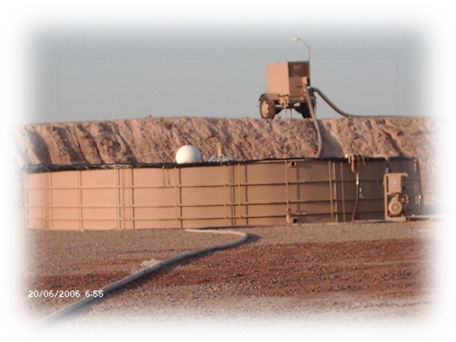
Highland Engineering, Inc.
1153 Grand Oaks Drive
Howell, MI 48843
(517) 548-4372 (517) 548-4423 (Fax)
Water Treatment and Troop Support Specialists
Water Storage and Distribution Solutions
Supplier of BEAR Water System Components
Source Run Pump (400 GPM)
Dual Pumping Station (350 GPM)
25,000 Gallon Quick Erect Tank
Waste Aeration and Mixing System
All BEAR Subsystems Including:
Source Run
150 Man Water Production
550 Initial Set
550 Follow-on Set
Many Others
USMC Tactical Water and Fuel System Components
DISTRIBUTION STATEMENT / LIMITED RIGHTS
Data contained herein is proprietary to Highland Engineering, Inc. and may not be used, disclosed, reproduced, modified, performed, or displayed without the prior written approval of Highland Engineering, Inc. This data is submitted with Limited Rights. This data may be reproduced and used by the government with the express limitation that they will not, without written permission of Highland Engineering, Inc., be used for purposes of manufacture nor disclosed outside the government, except that the government may disclose this data outside the government for the following purposes, if any, provide that the government makes such disclosure subject to prohibition against further use and disclosure: None.

Slide 13
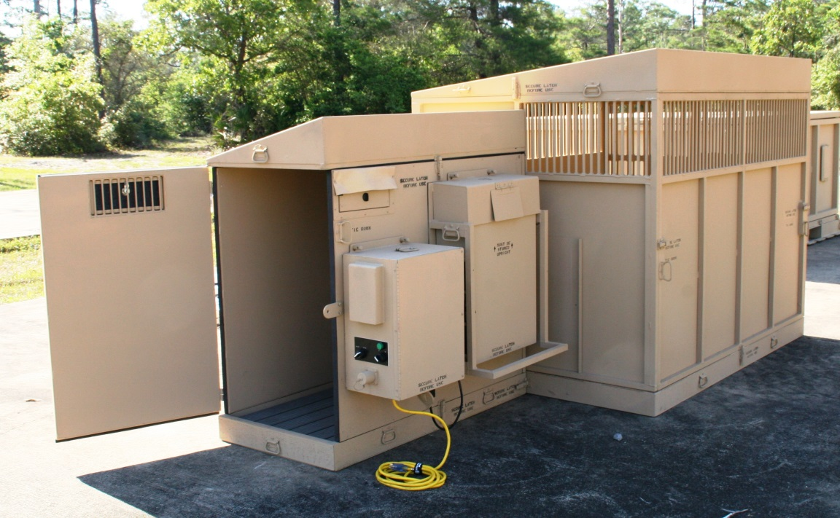
Highland Engineering, Inc.
1153 Grand Oaks Drive
Howell, MI 48843
(517) 548-4372 (517) 548-4423 (Fax)
Water Treatment and Troop Support Specialists
Military Working Dog Deployable Kennel System
(MWDKS)
Developed for US Army to provide for climate controlled rest and holding areas for working dogs – Urgent need existed n the AOR. Also a multi-service approved item.
Unit completely transportable in multiple ways - on air pallet, sling or in a HMMWV
Each component two-man lift – no tools or MHE required to assemble
Set-Up time less than 10 Minutes
Climate Controlled – On Board ECU.
120 VAC or 24VDC Operation
Complete weight 910#
Asembled: 125” x 52”
P/N: 701-3372
NSN: 3770-01-630-7307
DISTRIBUTION STATEMENT / LIMITED RIGHTS
Data contained herein is proprietary to Highland Engineering, Inc. and may not be used, disclosed, reproduced, modified, performed, or displayed without the prior written approval of Highland Engineering, Inc. This data is submitted with Limited Rights. This data may be reproduced and used by the government with the express limitation that they will not, without written permission of Highland Engineering, Inc., be used for purposes of manufacture nor disclosed outside the government, except that the government may disclose this data outside the government for the following purposes, if any, provide that the government makes such disclosure subject to prohibition against further use and disclosure: None.

